Slide 2
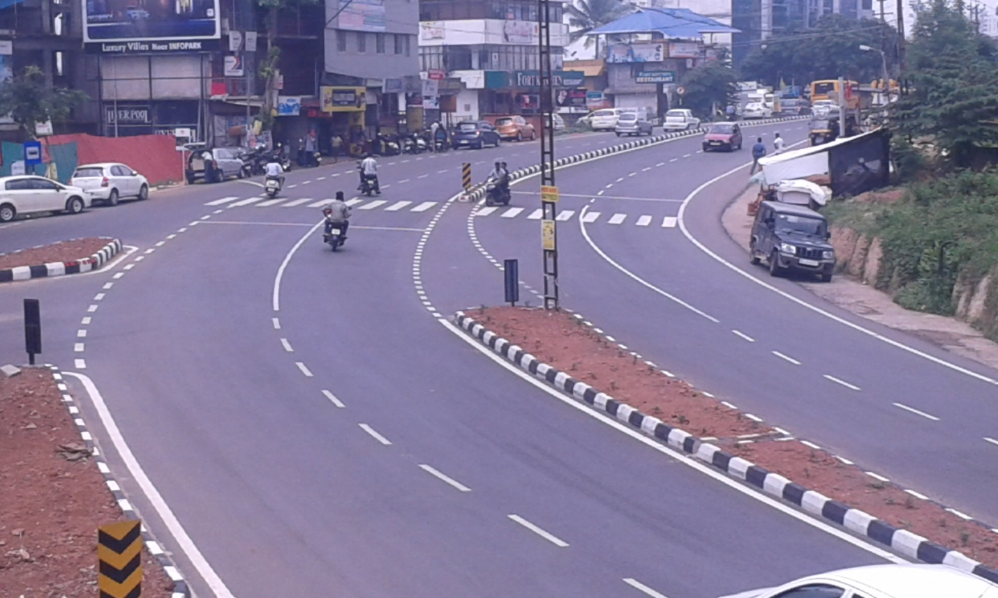
Roads And Bridges Development
Corporation of Kerala LTD
Road to Prosperity
Project Review Meeting –
1st July 2015

Slide 3
ONGOING PROJECTS
FLYOVER AT PALARIVATTOM
ROB AT ALOOR-MALA
ROB AT ANGADIPURAM
4. RIVER BRIDGES AT MAHILALAYAM-CHOWARA Seaport Airport Road Phase II Section B
5. ROB AT KUMARANALLOOR
6. ROB AT KUNHIPPALLY
7. ROB AT EROOR
8. ROB AT DIVINE NAGAR

Slide 4
FLYOVER AT PALARIVATTOM

Slide 5
PROGRESS STATUS
All substructure works completed
Girder casting (68/122) completed
20 girders launched; 6 on Edappally side and 14 on Vyttila side.
Service road on Edappally and Vyttila sides completed up to DBM.
Casting of precast drain started.

Slide 6
WORKS DURING JUNE 2015
TARGETED
ACHIEVED
Pier – 1 no (P18)
Pier cap – 1 no (P18)
Girder casting – 15 nos
Girder Launching – 18 nos
Precast Drain – 200 m
Deck Slab – 2 nos
Pier – 1 no (P18)
Pier cap – 1 no (P18)
Girder casting – 18 nos
Girder Launching – 18 nos
Precast Drain – 62 m
Deck Slab – Zero

Slide 7
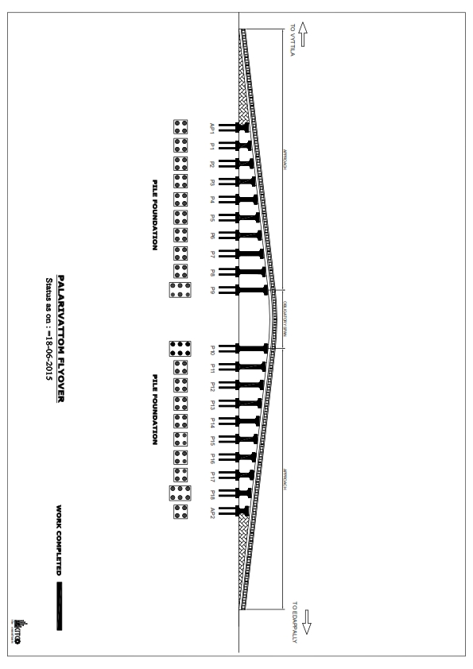
PROGRESS GRAPH

Slide 8
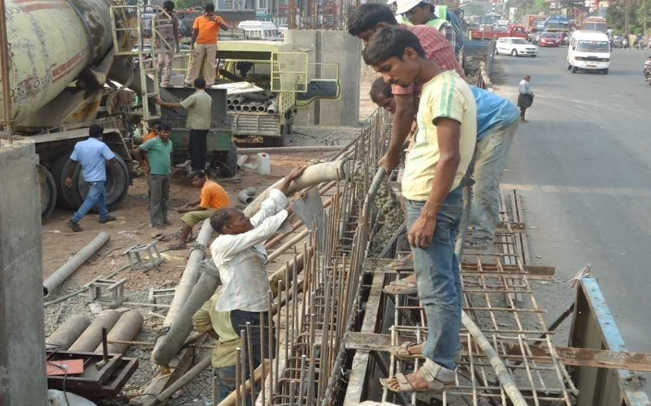
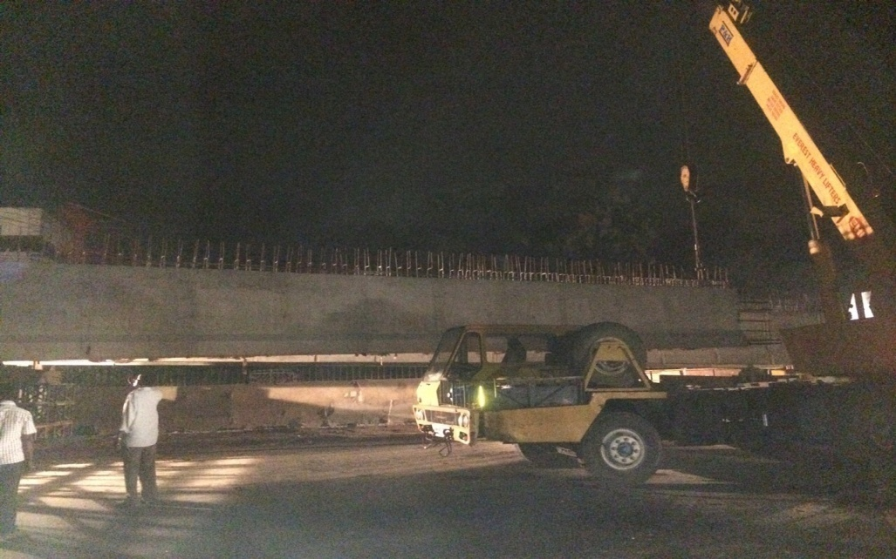
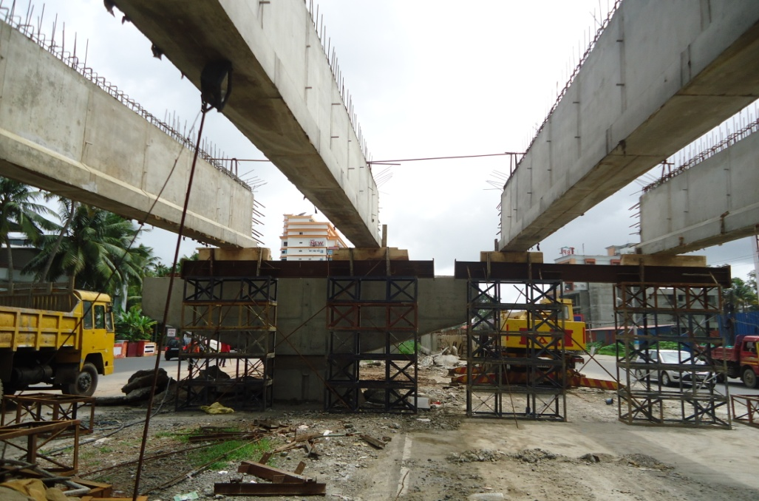
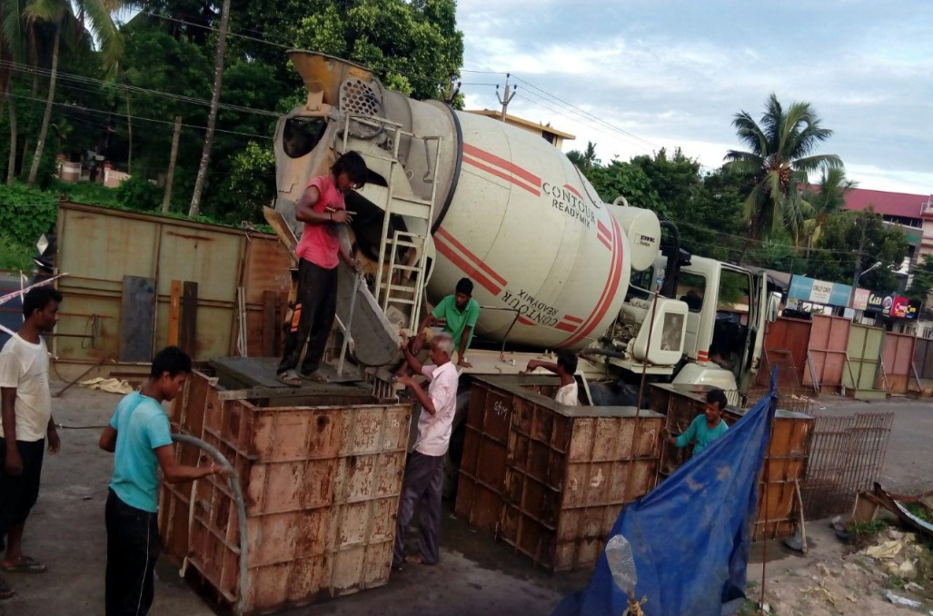
PROGRESS PHOTOS
Girder Concreting
Girder Launching
Launched Girders in AP1-P1 span
Casting of precast drain

Slide 9
ROB AT ALOOR-MALA

Slide 10
PROGRESS STATUS
All superstructure works and approach road completed except wearing coat of one adjacent span.
The balance works include painting, road marking, construction of staircases and toll booth.
Railway span is being executed by RAILWAYS. The parapet wall to be constructed.

Slide 11
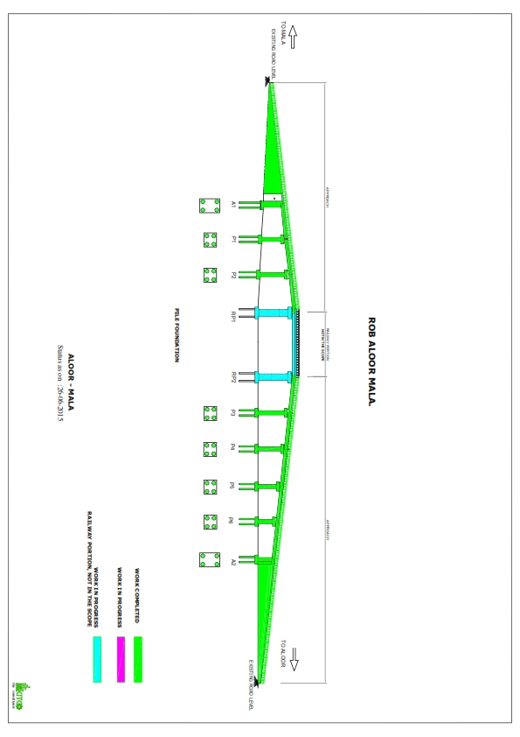
PROGRESS GRAPH

Slide 12
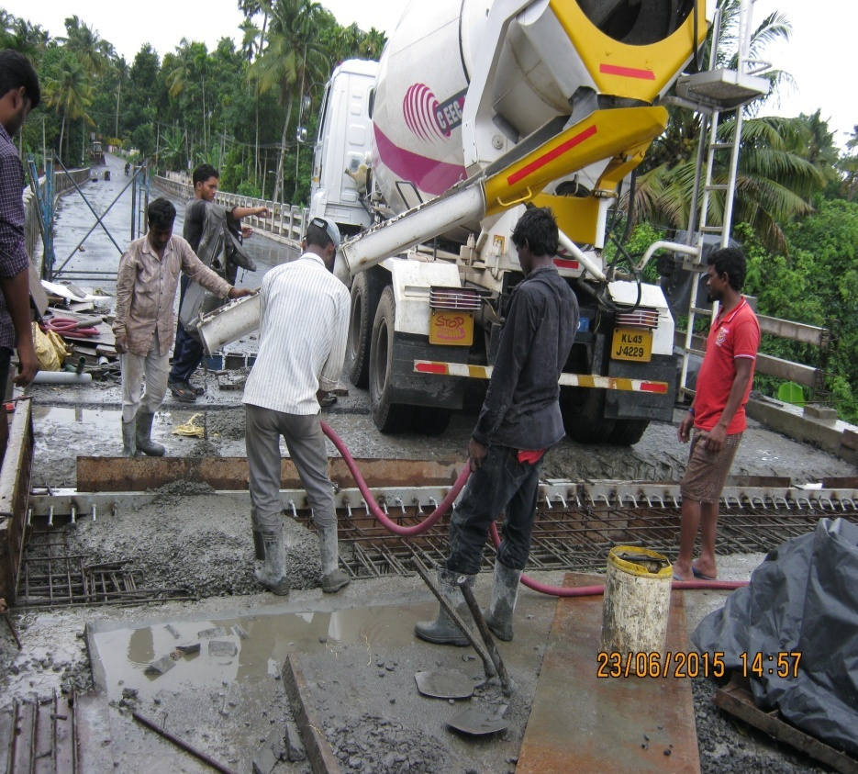
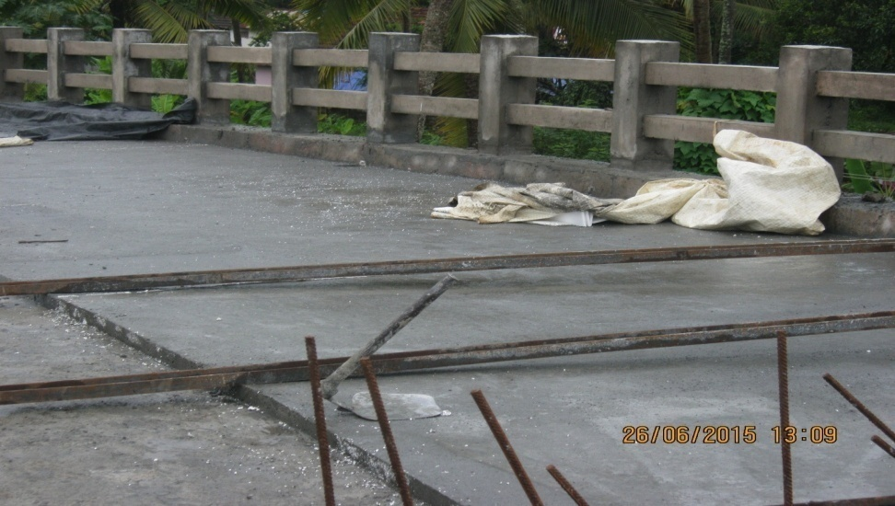
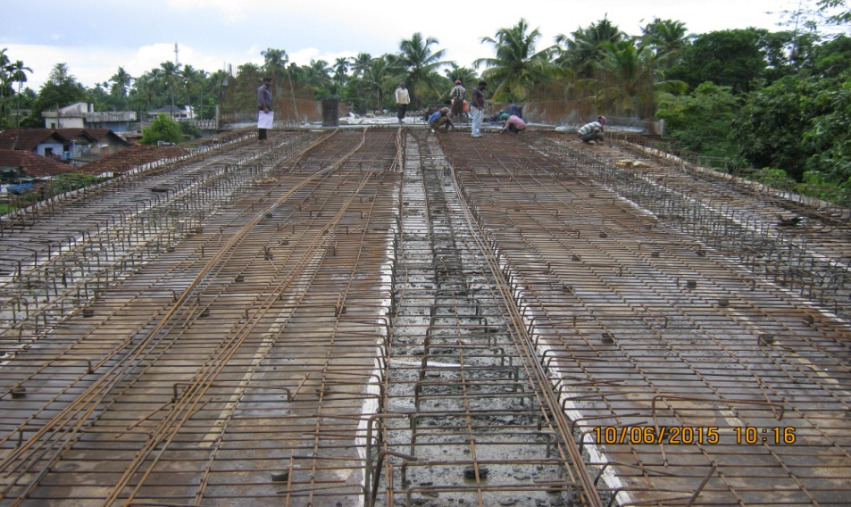
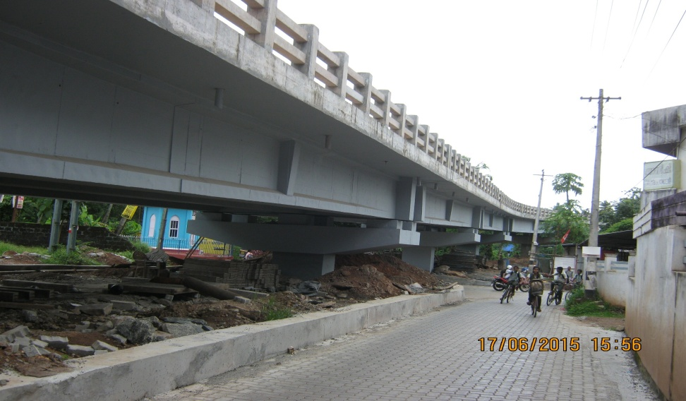
PROGRESS PHOTOS
Expansion joint
CC Wearing coat in adj.span
Reinforcement for adj.span
Painting

Slide 13
ROB AT ANGADIPURAM

Slide 14
PROGRESS STATUS
Piling completed. Pile cap (13/18), Pier (11/18), Pier cap (9/18) and Girders (3/54) are completed.
45% of retaining wall and 40m drain completed on Angadipuram side.

Slide 15
WORKS DURING JUNE 2015
TARGETED
Pier cap – 1 (P14)
Girder – 1 (P3-P4)
Deck Slab – 1 (P3-P4)
Retaining wall (Angadipuram side) – 100%
Service road (Perinthalmanna side) – 100%
Drain – 100m
Building Dismantling – 100%
ACHIEVED
Pier cap – 1 (P14)
Girder – 1 (P3-P4)
Deck Slab – Zero
Retaining wall (Angadipuram side) – 45%
Service road (Perinthalmanna side) – 0%
Drain – 40m
Building Dismantling – 95%

Slide 16
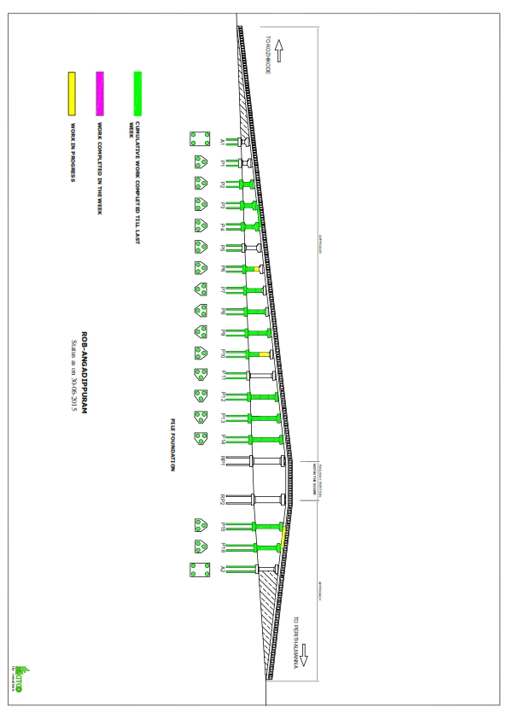
PROGRESS GRAPH

Slide 17
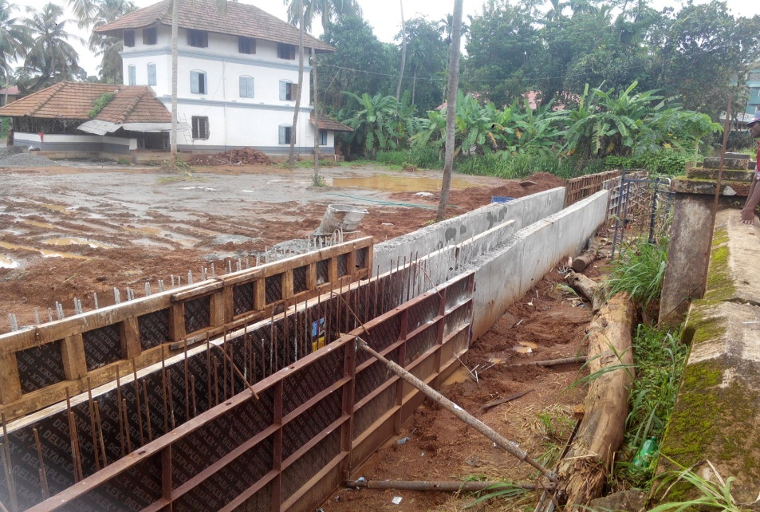
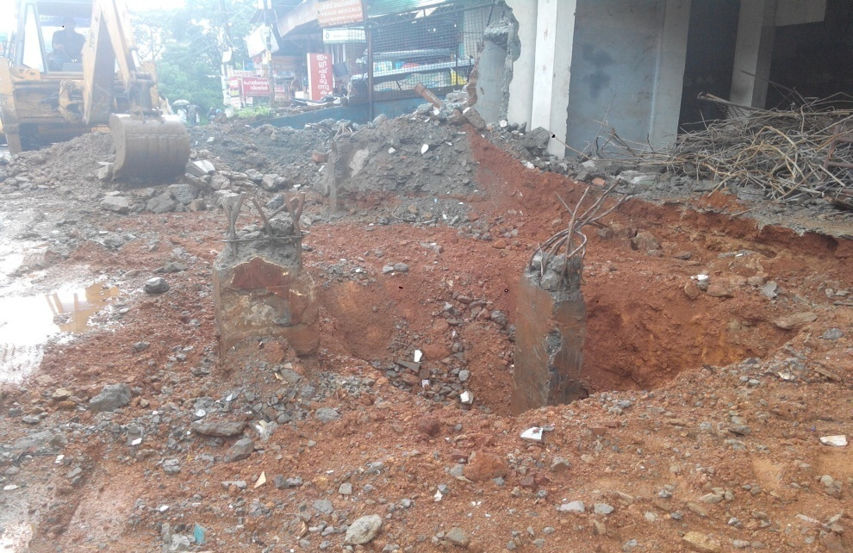
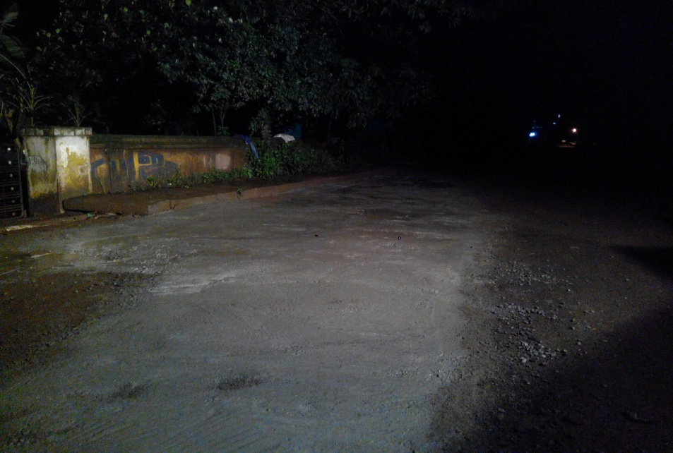
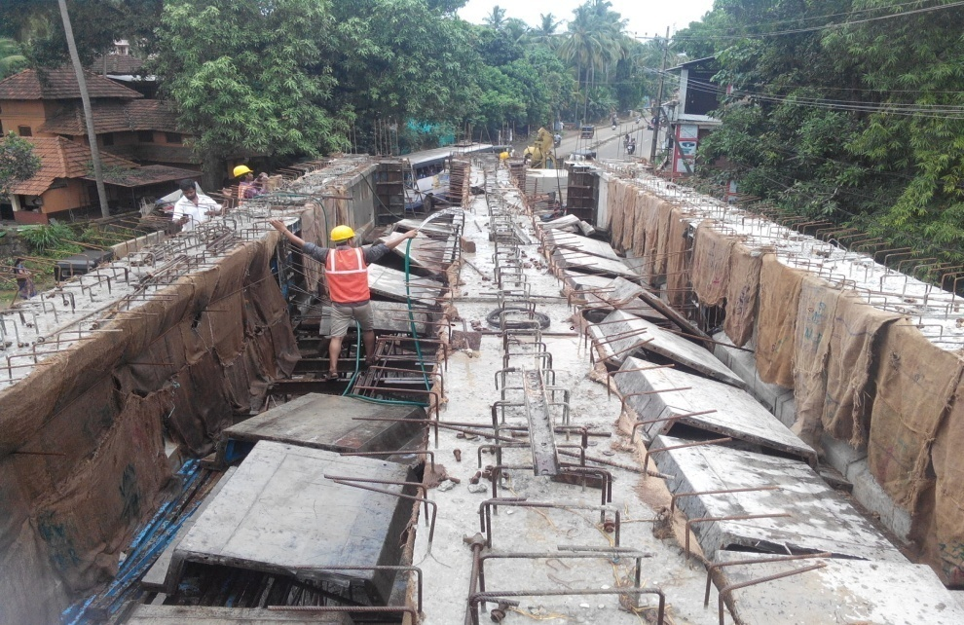
PROGRESS PHOTOS
Drain work on Angadipuram side
Building dismantling
Road repairing
Girder P3 – P4

Slide 18
RIVER BRIDGES AT MAHILALAYAM-CHOWARA Seaport Airport Road Phase II Section B

Slide 19
PROGRESS STATUS OF MAIN BRIDGE
All works up to Pier cap completed
Girders (40/48) casted and 36 girders launched
Deck slabs (6/12) casted.

Slide 20
PROGRESS STATUS OF MINOR BRIDGE
Pile (13/17), Pile cap (4/5), Pier (4/5), Pier cap(4/5) and Girders (10/16) are completed.

Slide 21
WORKS DURING JUNE 2015
TARGETED
ACHIEVED
Main Bridge
Girder – 4 nos (2 nos each in P1-P2& P2-P3)
Girder Launching – 8 nos (4 nos each in P2-P3 & P3-P4)
Deck Slab – 1 (P6-P7)
Minor Bridge
Girder – 2 nos(P2’-P3’)
Main Bridge
Girder – 3 nos (1 no in P1-P2& 2 nos in P2-P3)
Girder Launching – 4 nos (4 nos in P3-P4)
Deck Slab – 1 (P6-P7)
Minor Bridge
Girder – 1 no(P2’-P3’)

Slide 22
PROGRESS GRAPH

Slide 23
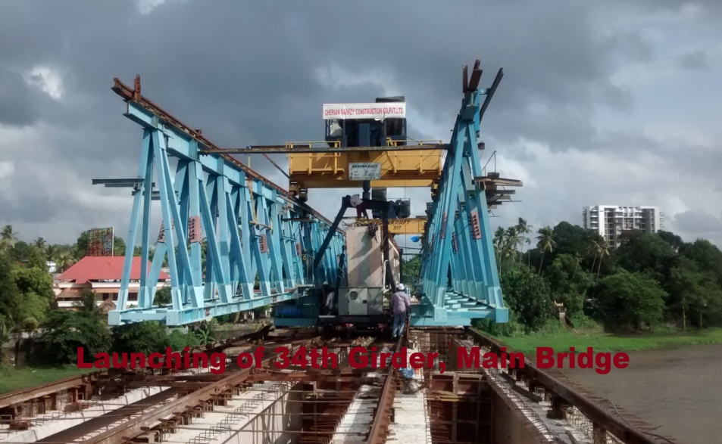
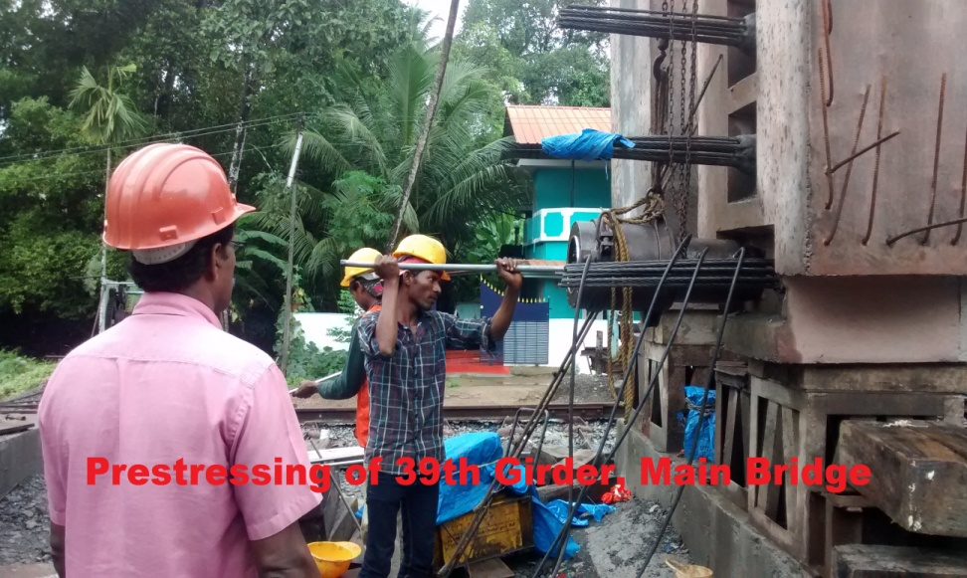
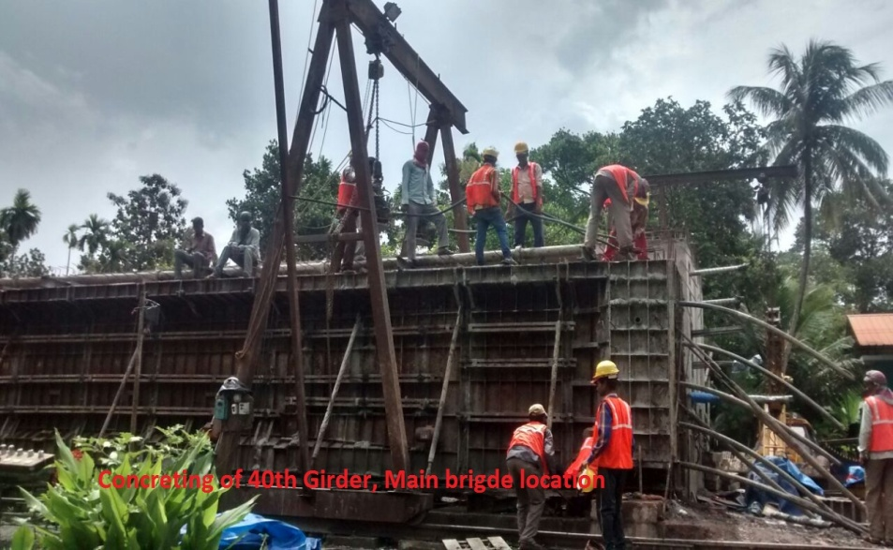
PROGRESS PHOTOS

Slide 24
ROB AT KUMARANALLOOR

Slide 25
PROGRESS STATUS
The ROB was inaugurated and opened to traffic on May 24,2015.
Construction of staircases and toll booth to be completed.

Slide 26
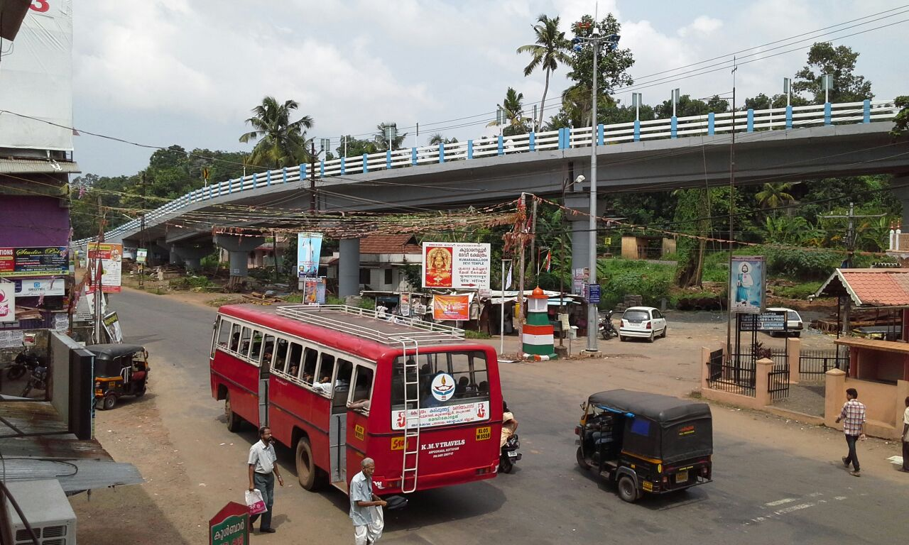
ROB AT KUMARANELLUR

Slide 27
ROB AT KUNHIPPALLY

Slide 28
PROGRESS STATUS
All works up to pier cap completed
Out of 16 spans, girder and slab casting completed in 14 spans
Expansion joint and kerb works completed in 12 spans
Handrail work completed in 8 spans
Retaining wall on Monthal side completed
Retaining wall on NH side to be started. Here work can be completed only after getting possession of land owned by Late Dr. Irfan Habeeb.

Slide 29
WORKS DURING JUNE 2015
TARGETED
ACHIEVED
Girder – 1 (Adjacent span on Monthal side)
Expansion joint – 3 nos
Handrail – 5 spans
Painting (P5-P6) – 30%
Drain (Monthal side) –Complete
Retaining Wall (Monthal side) – Complete
Dirt Wall – 2 nos (A1,A2)
Girder – Zero (Adjacent span on Monthal side)
Expansion joint – 3 nos
Handrail – 5 spans
Painting (P5-P6) – 20%
Drain (Monthal side) – 98%
Retaining Wall (Monthal side) – Complete
Dirt Wall – 1 no (A2)

Slide 30
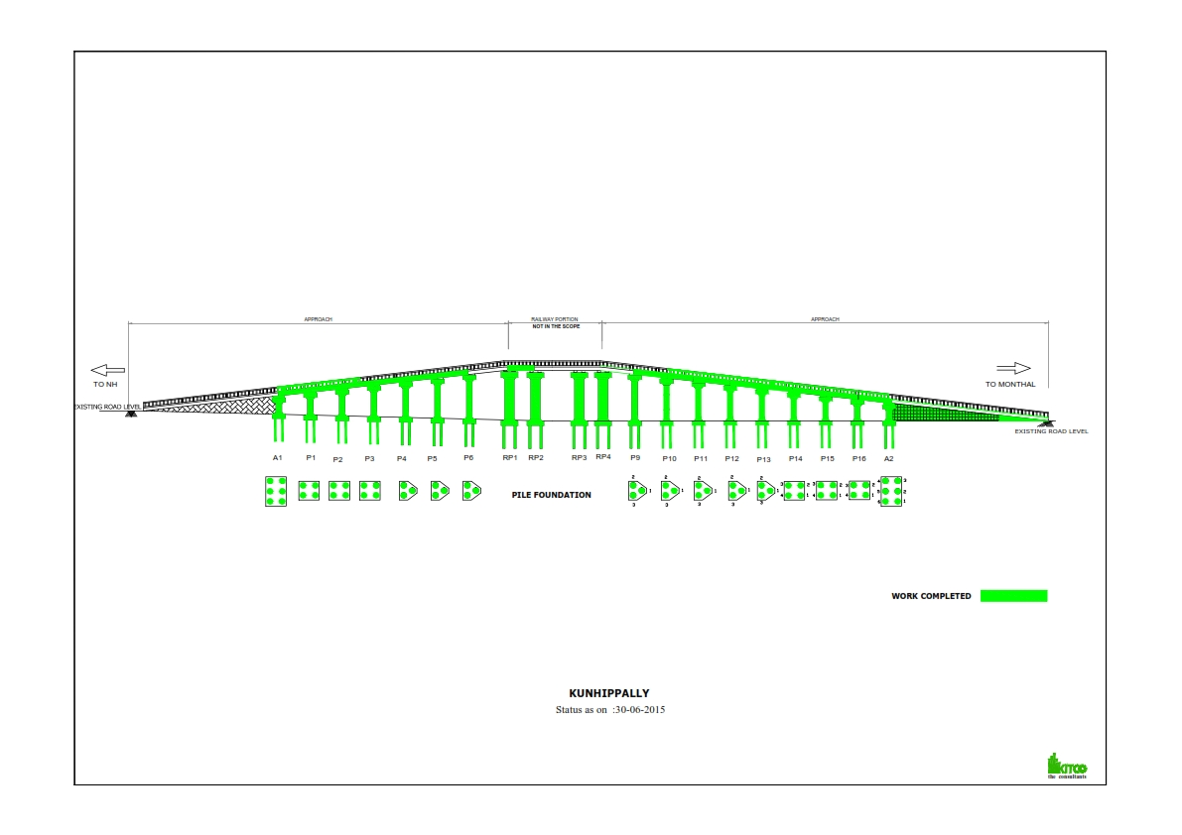
PROGRESS GRAPH

Slide 31
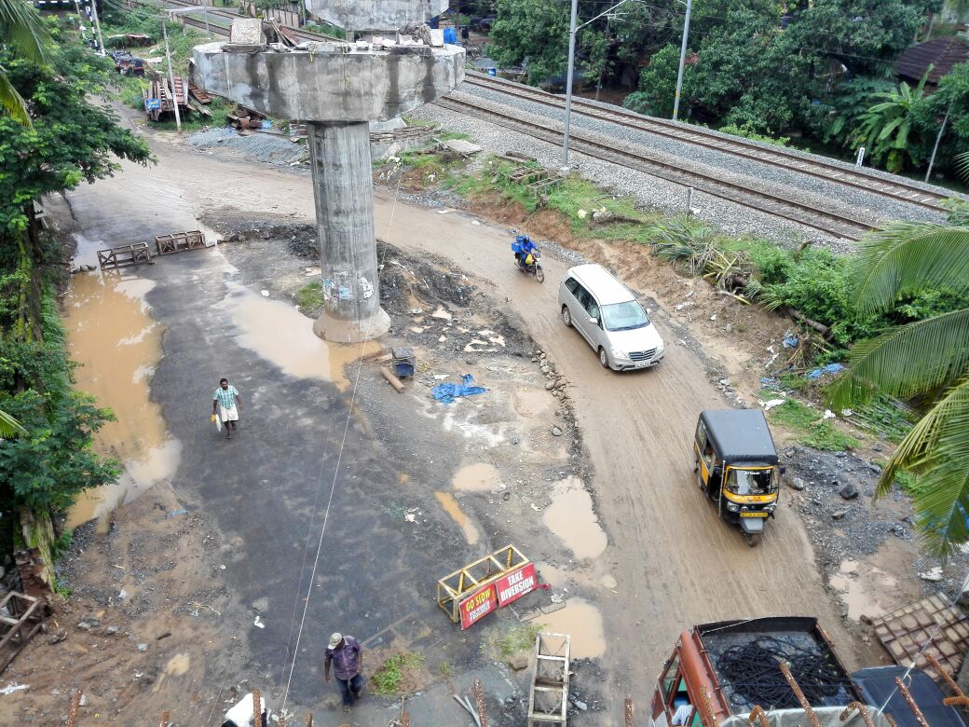
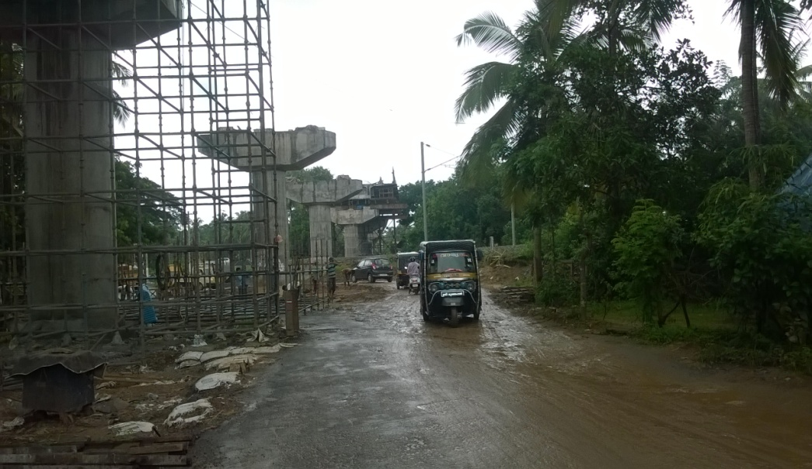
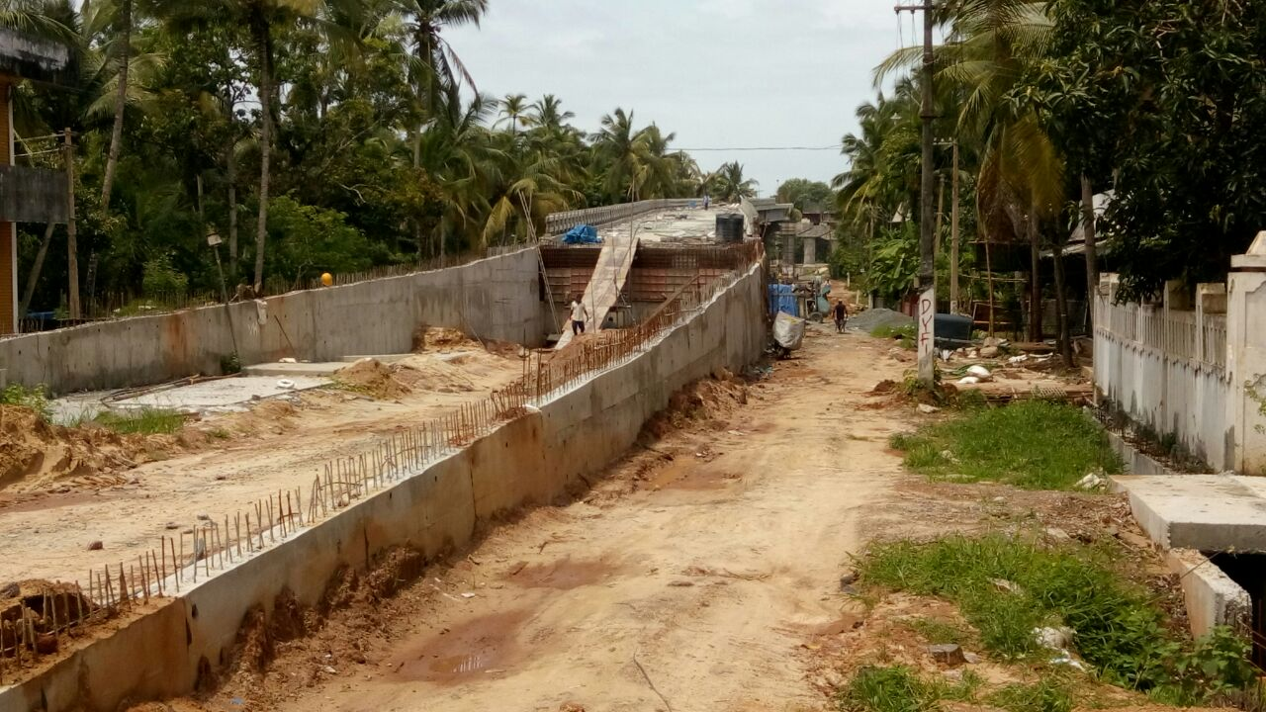
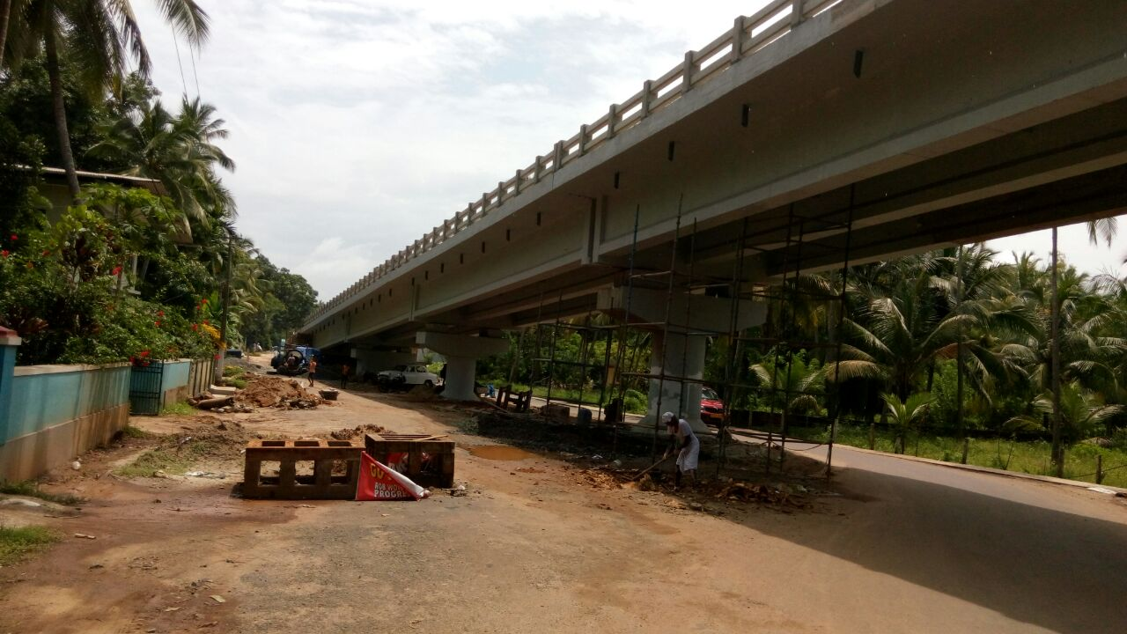
PROGRESS PHOTOS
Diversion Road-Monthal side
Staging Work
Dirt Wall – A2
Painting in Progress

Slide 32
ROB AT EROOR

Slide 33
PROGRESS STATUS
Piling completed. Pile cap (7/10), Pier (4/10) and Pier cap (4/10) are completed.
Slab casting started and (1/10) is completed
Construction of service roads to be started

Slide 34
WORKS DURING JUNE 2015
TARGETED
Pile – 7 nos (2 nos in P8 & P7, 3 nos in A2)
Pile cap – P5,P6,P7
Pier – P5,P6,P7
Drainage – 50 m
Span – 2 (P2-P3 & P1-P2)
ACHIEVED
Pile – 7 nos (2 nos in P8 & P7, 3 nos in A2)
Pile cap – P5,P6
Pier – Zero
Drainage – 50 m
Span – 1 (P2-P3)

Slide 35
PROGRESS GRAPH

Slide 36
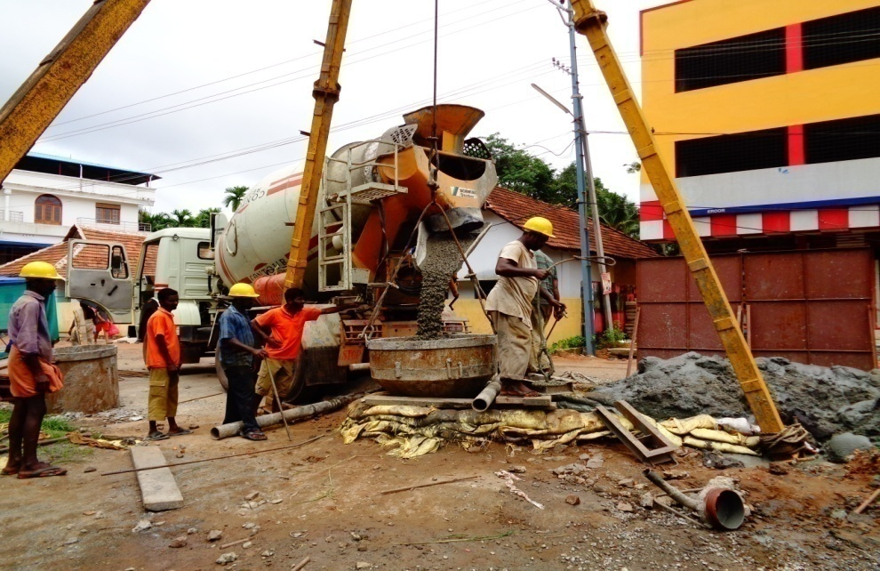
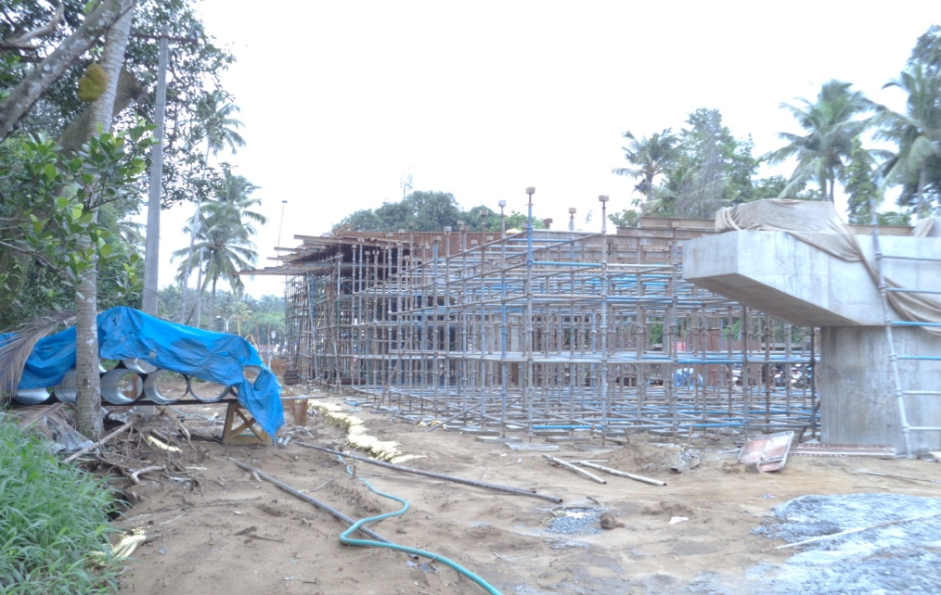
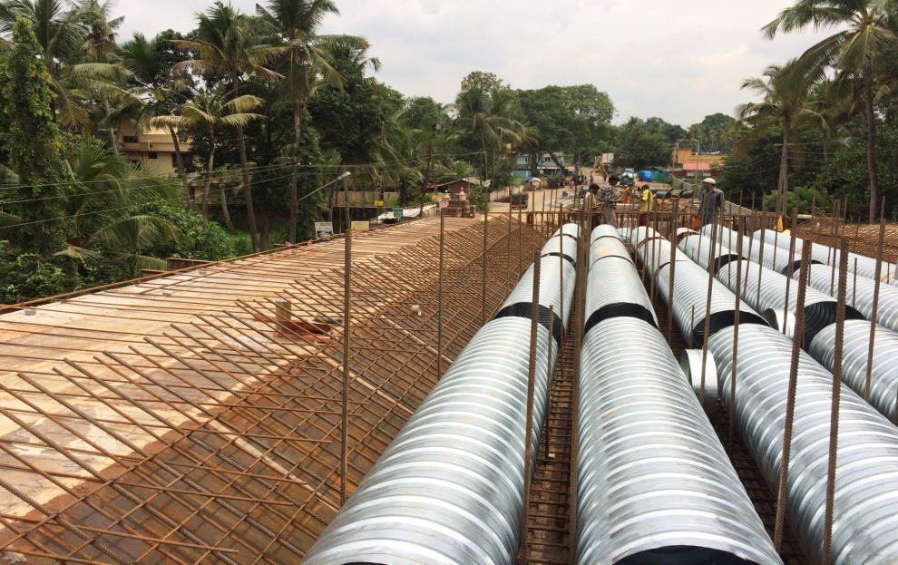
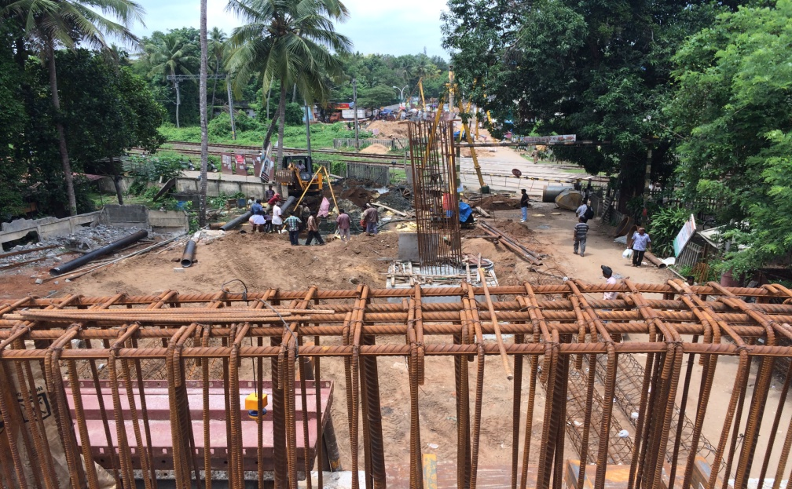
PROGRESS PHOTOS
Pile Casting
Staging for P1-P2 span
Placing of Voids in span P2-P3
View from P2 – P3 span

Slide 37
ROB AT DIVINE NAGAR

Slide 38
ADJACENT SPANS OF DIVINE NAGAR ROB
Casting of Slab in adjacent span RP1-P6A completed
Handrail and Kerb works started in RP1-P6A span.
Setting out completed for constructing staircase at Divine Side
Works in adjacent span RP2-P7 to be started

Slide 39
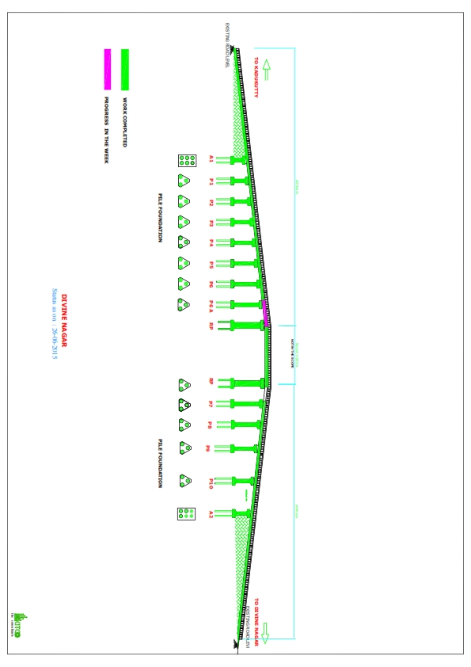
PROGRESS GRAPH

Slide 40
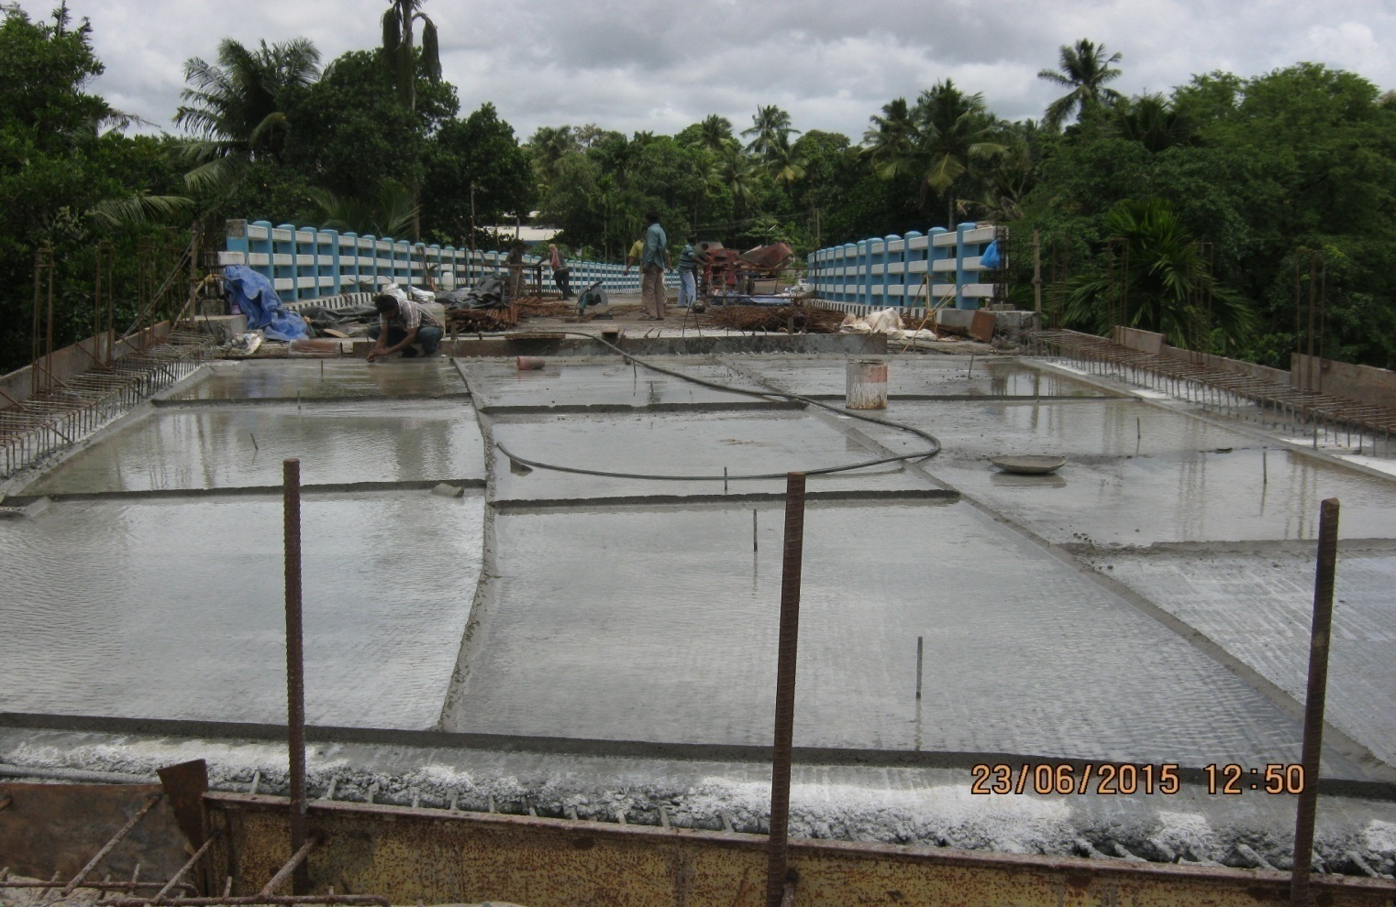
ADJACENT SPAN RP1-P6A Kadukutty Side

